Slide 1
Performance-Induced CEO Turnover
Dirk Jenter London School of Economics and Political Science and CEPR
Katharina Lewellen Tuck School of Business, Dartmouth College
Presented by Austin Francis

Slide 2
Research Question
The sources aim to determine whether poor firm performance leads to the end of CEO-firm matches, regardless of the specific mechanism of separation.
The research seeks to understand the prevalence of performance-induced CEO turnover as a distinct category from forced or voluntary turnover.
The study questions the accuracy of prior research on forced CEO turnover given the challenges in identifying true forced departures.

Slide 3
Prior Literature
Prior studies on CEO turnover and firm performance primarily focused on identifying forced departures using algorithms based on CEO characteristics and turnover process details.
These studies typically found a weak relationship between performance and forced turnover, leading to the conclusion that dismissals are not a significant incentive for CEOs.
The limited impact of performance on CEO turnover was often attributed to CEO entrenchment and weak corporate governance, particularly for long-tenured CEOs.

Slide 4
Hypothesis
The authors challenge the prevailing view of CEO turnover and implicitly suggest that: classifying CEO departures solely as forced or voluntary may underestimate the influence of performance.

Slide 5
Data Collection
The study constructs a sample of CEO turnovers from the Standard & Poor's ExecuComp database, spanning 1993 to 2011 and encompassing firms in the S&P 500, MidCap, and SmallCap indices.
CEO turnover events are verified and corrected using news searches in the Factiva database to ensure accuracy and completeness.
Turnovers are classified as forced or voluntary using the Parrino (1997) algorithm, which relies on information from press reports and the timing and circumstances of CEO departures.

Slide 6
Results
The study finds that 38% to 55% of all CEO turnovers are performance-induced, considerably higher than the proportion of forced turnovers identified in previous research.
Turnovers traditionally classified as "voluntary" show a strong correlation with poor performance, indicating that many are likely driven by performance-related factors.
The research highlights the importance of recent performance (3 to 4 years) in driving performance-induced CEO turnover, with older performance signals having limited influence.

Slide 7

Model Explanation
Notes:
●
This paper utilizes two primary models to examine the relationship between CEO turnover and firm performance. The first is a standard probit model with performance decile indicators1.
○
This model assumes that the probability of performance-induced turnover is zero at a high performance threshold. Any turnover above that threshold is assumed to be unrelated to performance. The turnover rate at or above the threshold is then used to estimate the rate of "other" turnover1.
○
The model has limitations as it only allows for a single performance measure and the estimated coefficients are not directly comparable to those from other models2.
●
The second is a two-probit model that explicitly accounts for two separate turnover processes – one influenced by performance and one that isn't3.
○
The first probit process estimates performance-induced turnover, while the second probit process estimates the rate of "other" turnover3.
○
The two-probit model is more versatile as it can incorporate multiple performance measures and the coefficients can be used to test Bayesian learning models4.
○
This model is more advantageous for estimating performance-induced turnover as it can accommodate multiple performance terms with differing weights

Slide 8
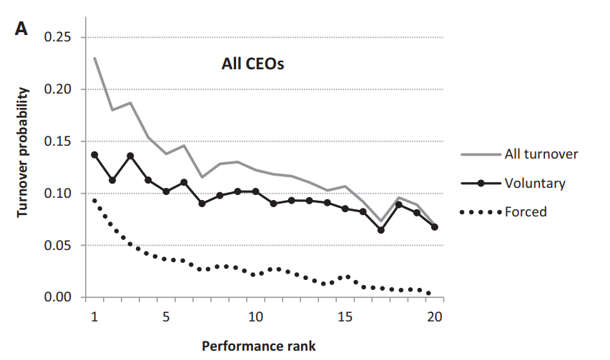
Notes:
Figure 1 from Jenter & Lewellen (2020) illustrates how CEO turnover probability changes in response to firm performance. The horizontal axis in both panels represents firm performance, ranked into 20 percentiles based on industry-adjusted stock returns. The vertical axis indicates the annual probability of CEO turnover. Panel A examines all CEOs, showing that overall turnover ("All Turnover") increases as performance worsens. Importantly, both "Forced" and "Voluntary" turnover lines also slope downwards, indicating that even "voluntary" departures are more common after poor performance12.

Slide 9
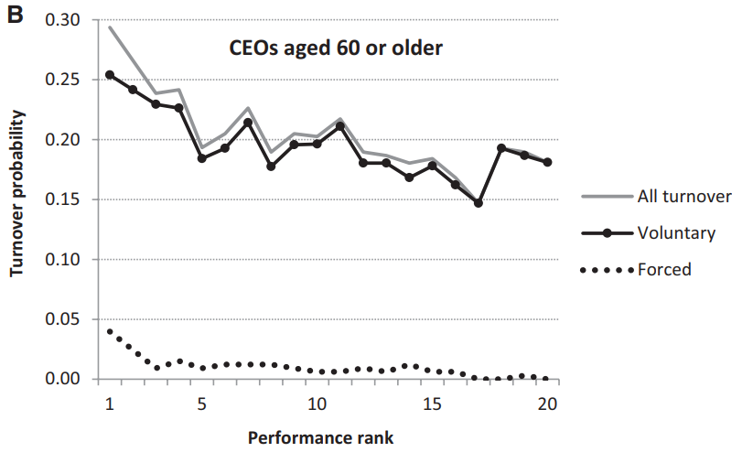
Notes:
Panel B focuses on CEOs aged 60 or older. Notably, the "Forced" turnover line is nearly flat, suggesting forced departures are less frequent in this age group2. However, the "All turnover" line maintains its downward slope, indicating that older CEOs are still susceptible to performance-related departures2. This difference highlights a central argument of the paper: classifications like "forced" vs. "voluntary" may not fully capture the influence of performance on CEO departures, especially for older CEOs who are less likely to be explicitly fired123. Many departures labeled "voluntary," particularly for older CEOs, might actually be triggered by poor performance, a phenomenon the authors term "performance-induced turnover"

Slide 10
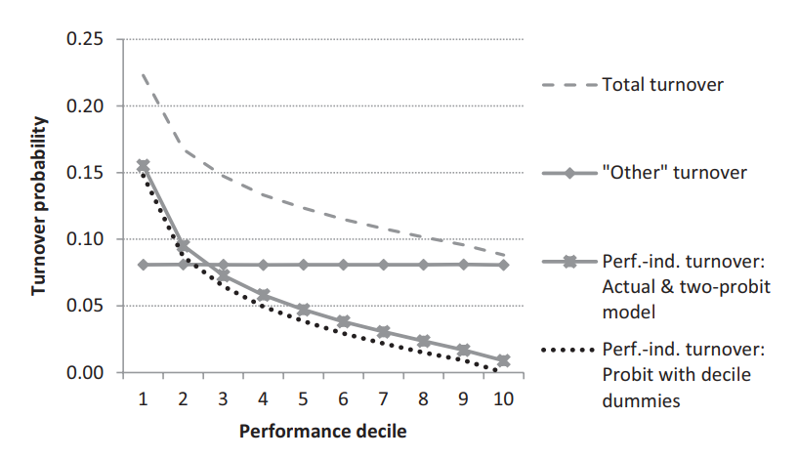
Notes:
Figure 2 from Jenter & Lewellen (2020) visually represents the results of a simulated example designed to test two different methods for estimating "performance-induced" CEO turnover. This figure shows how accurately the two methods can identify which CEO departures were truly influenced by company performance.
In this simulated example, the researchers created a scenario where they knew exactly which CEO departures were caused by poor performance and which were due to other factors. They then used their two estimation methods — a standard probit model with performance decile indicators and a two-probit model — to see how well each method could identify the "performance-induced" departures. Figure 2 demonstrates that both methods are fairly accurate in capturing the relationship between performance and CEO turnover, closely matching the actual turnover probabilities observed in the simulated data. However, the two-probit model proves to be slightly more accurate, especially in identifying those performance-related departures that occur even when companies are performing relatively well. This finding supports the authors' argument that a more nuanced approach, like the two-probit model, is necessary to fully understand the complex dynamics of CEO turnover.123

Slide 11
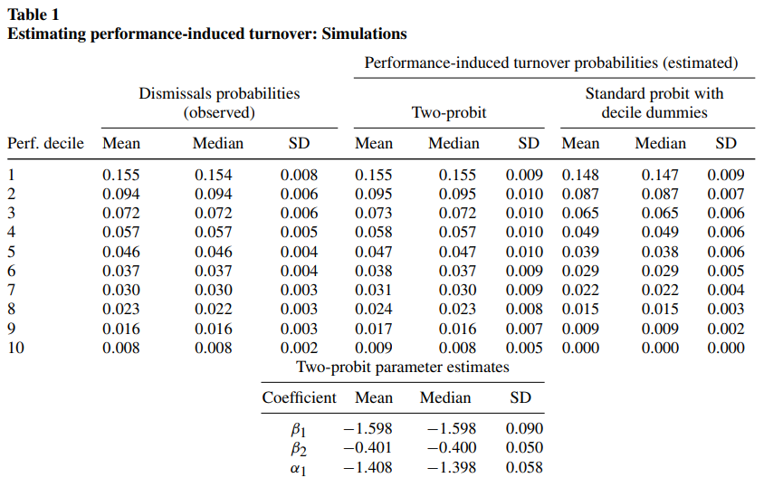
Notes:
Table 1 from Jenter & Lewellen (2020) provides a detailed look at the results of the simulated example discussed in Figure 2, showcasing how well the authors' two methods for estimating "performance-induced" turnover perform when they know the true underlying causes of CEO departures. The table is divided into two sections. The top section compares the estimated probabilities of performance-induced turnover obtained from the two methods (a standard probit model and a two-probit model) to the actual probabilities observed in the simulation. Each row in this section represents a different performance decile, with decile 1 representing the worst-performing companies and decile 10 representing the best. As you can see, both methods do a pretty good job of estimating the true probabilities, but the two-probit model consistently produces estimates that are closer to the actual values.
The bottom section of Table 1 focuses on the estimated coefficients from the two-probit model. These coefficients represent the sensitivity of CEO turnover to changes in firm performance. Again, the results demonstrate that the two-probit model can accurately recover the true parameters used in the simulation. This accuracy is critical for the authors' broader argument because it provides confidence that the two-probit model can be used to reliably estimate performance-induced turnover in real-world data, where the true causes of CEO departures are not known. By demonstrating the effectiveness of their method in a controlled setting, Jenter & Lewellen lay the groundwork for applying their insights to real companies and CEOs, ultimately leading to a more accurate understanding of the factors driving CEO turnover.

Slide 12
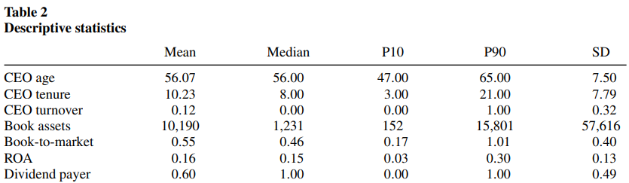
Notes:
it introduces us to the data they used to study CEO turnover. Think of it as a snapshot of the companies and CEOs included in their analysis.
The authors built their sample using data from Standard & Poors ExecuComp database, a treasure trove of information about top executives in large US companies. They focused on the period from 1993 to 2011 – a pretty substantial chunk of time that captures a lot of economic ups and downs. They also carefully verified each instance of CEO turnover using news articles from Factiva, a powerful database for business research. This verification process ensures that they're working with accurate and reliable information. Why is this so important? Well, if the data is flawed, any conclusions drawn from it could be misleading. The authors are demonstrating their commitment to rigorous research by being transparent about their data sources and the steps they took to clean and verify the information.

Slide 13
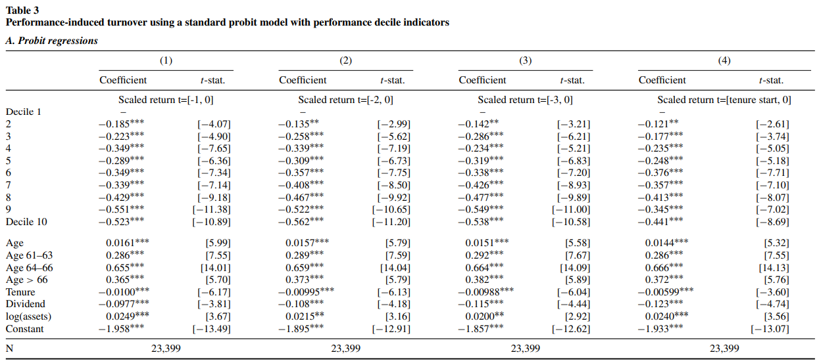
Notes:
You're right, Table 3, Panel A is where Jenter & Lewellen (2020) really get down to business! They've laid the groundwork by explaining their concept of performance-induced CEO turnover, and they've shown us the data they're working with. Now, they're using a statistical model (a probit regression) to test whether poor company performance actually leads to CEO departures.
The dependent variable in these regressions is an indicator variable that equals 1 if the CEO left the company during that particular tenure year, and 0 if they stayed. This means the researchers are looking at whether or not a turnover occurred in a given year, rather than just the CEO's overall tenure at the company. They are trying to see if bad performance in a particular year increases the chances of the CEO leaving in that same year.
Again, the bolded numbers in Table 3, Panel A represent the coefficients for each decile of the company's stock price performance. The authors use four different models to measure performance:
●
Model 1: Average stock return from the year before the CEO's tenure began through the year of potential turnover
●
Model 2: Average stock return from two years before tenure began through the year of potential turnover
●
Model 3: Average stock return from three years before tenure began through the year of potential turnover
●
Model 4: Average stock return over the CEO's entire tenure up to and including the year of potential turnover
As you pointed out, the coefficients become increasingly negative as performance worsens – meaning that CEOs of companies with poor stock performance are much more likely to leave their positions. This finding, again, supports the authors' central argument that boards pay close attention to performance and are more likely to replace CEOs who aren't delivering the goods for shareholders.1

Slide 14
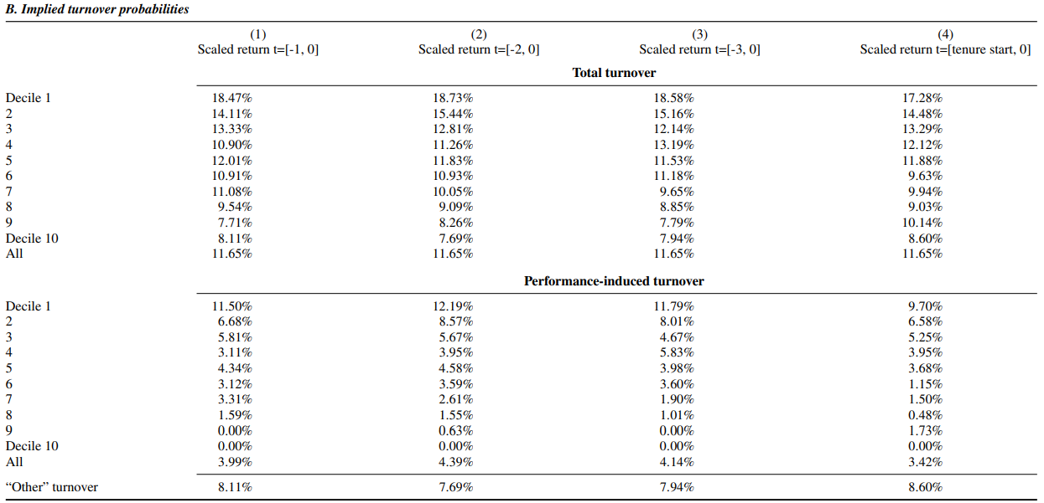
Notes:
Table 3, Panel B shifts from the raw regression results to the implied turnover probabilities, which are calculated from the coefficient estimates shown in Panel A. These probabilities provide a more intuitive understanding of the relationship between company performance and CEO turnover. The authors included this panel to illustrate the practical implications of their statistical models. Instead of just seeing coefficients, we can see how changes in stock performance actually translate into different likelihoods of CEO departures.
The independent variables are still the different measures of stock performance, categorized into deciles. The dependent variables, however, are now the implied probabilities of different types of turnover. The researchers calculate these probabilities based on the regression results and the assumption that turnover above the 90th percentile is unrelated to performance (what they call "other" turnover). The panel then breaks down the overall turnover probability for each decile into two components: performance-induced turnover and "other" turnover.
"Alright, so Table 3, Panel B shows us what the results from Panel A actually mean in the real world. Instead of just looking at coefficients, we can now see the actual percentage chance that a CEO will leave the company based on their company's stock performance. Remember, the researchers are using a statistical model to estimate these probabilities. They are assuming that any CEO turnover in companies with really good stock performance – above the 90th percentile – is not due to performance issues, but rather other factors, like retirement or personal reasons. They call this "other" turnover.
The table shows that the overall probability of a CEO leaving the company increases dramatically as performance gets worse. For example, if we look at Model 2 (which looks at stock returns over the two years before the CEO's tenure began), the overall turnover probability is about 8% for companies in the top performance decile, but jumps to almost 19% for companies in the bottom decile. But here's the interesting part: this increase is almost entirely driven by what the authors call performance-induced turnover – meaning turnover that is likely caused by the company's bad performance. This suggests that boards are actively replacing CEOs when their companies are underperforming, even if those departures are not officially classified as "forced.""

Slide 15
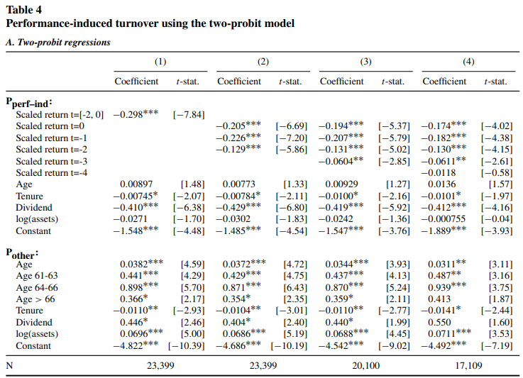
Notes:
Table 4, Panel A might seem a bit intimidating at first glance, but it's really just a more refined way of looking at the same question we explored in Table 3 – how does company performance affect the likelihood of a CEO leaving? This time, the authors are using a statistical technique called a "two-probit model," which allows them to estimate the probability of performance-induced turnover more directly without having to rely on arbitrary performance thresholds.
Think of it like this: they're essentially running two separate models. The first model (Pperf–ind) focuses specifically on how bad performance increases the chances of a CEO leaving. It includes the same kind of stock performance measures we saw in Table 3, along with some standard control variables. The second model (Pother) looks at factors other than performance that might lead to a CEO leaving, things like age, retirement patterns, and other company characteristics. By comparing the results of these two models, the authors can tease out the specific impact of poor performance on CEO turnover.
The authors included this second model to address some limitations of the standard probit model, which requires choosing an arbitrary performance threshold (the 90th percentile in Table 3) above which all turnovers are assumed to be unrelated to performance.
The dependent variable in both probit equations is the same as in Table 3 – an indicator variable equal to 1 if the CEO left the company during that tenure year, and 0 if they stayed. However, the independent variables differ between the two equations. The first probit equation (labeled "Pperf–ind" in the table) includes measures of the firm's stock price performance along with other control variables, allowing the researchers to estimate the probability of performance-induced turnover. The second probit equation (labeled "Pother") focuses on factors unrelated to performance, such as CEO age and retirement patterns, to estimate the probability of "other" turnover.

Slide 16
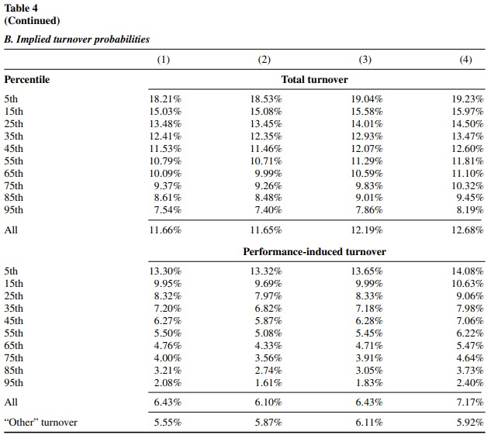
Notes:
1.
High-level summary of the table: Table 4, Panel B presents the model-implied probabilities of CEO turnover based on the two-probit model estimates from Panel A. The table shows the estimated probability of a CEO leaving the company for each performance percentile, along with a breakdown of those probabilities into performance-induced turnover and "other" turnover.1
2.
How the table fits in the overall narrative, why they included it: This table serves a similar purpose to Table 3, Panel B, providing a more concrete and interpretable way to understand the results of the statistical models. The authors included this panel to demonstrate the magnitude of the relationship between company performance and CEO turnover, showing that the likelihood of a CEO departing increases substantially as performance worsens.12
3.
What the independent and dependent variables are:
○
Independent variables: The independent variables are percentiles of the company's stock price performance.1
○
Dependent variables: The dependent variables are the model-implied probabilities of total turnover, performance-induced turnover, and "other" turnover.1
4.
A short 2-paragraph script that I can read to explain it:
5.
"Table 4, Panel B takes the results from our two-probit model and translates them into probabilities that are easier to grasp. Basically, we're looking at the percentage chance that a CEO will leave the company based on how well (or poorly) their company is performing in the stock market. These probabilities are calculated directly from the model estimates in Panel A.1
6.
The table shows that performance-induced turnover – meaning CEO departures that are likely due to poor company performance – is a significant factor in overall CEO turnover, even more so than the standard probit model suggested. For instance, if we look at Model 1 (which considers stock returns over a three-year period), the probability of a performance-induced turnover is around 13% for companies in the bottom 5th percentile of stock performance, compared to only about 2% for companies in the top 95th percentile. This highlights the strong link between poor performance and the likelihood of a CEO leaving the company and provides further evidence that boards are sensitive to performance when making CEO turnover decisions.12"

Slide 17
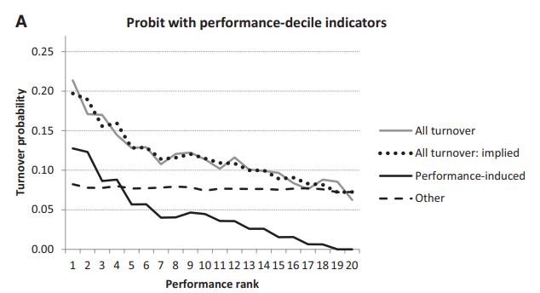

Slide 18
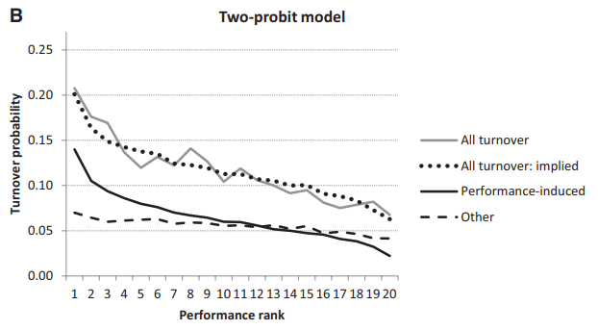

Slide 19
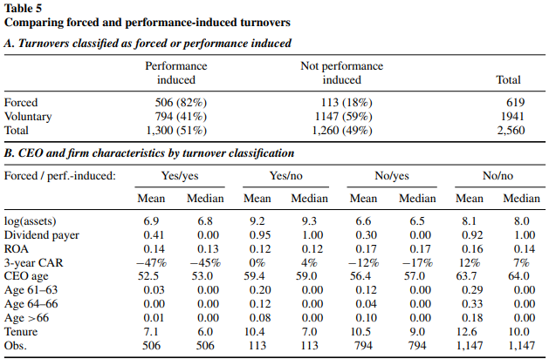
Notes:
Comparing Classifications: A Closer Look at Table 5
1.
High-level summary of the table: Table 5 directly compares the authors’ concept of performance-induced CEO turnover with the more traditional classification of forced turnover. Panel A presents a cross-tabulation of CEO departures based on both classifications, showing the percentage of turnovers that fall into each of the four possible categories (forced and performance-induced, forced but not performance-induced, etc.). Panel B then examines the characteristics of CEOs and firms associated with each of these four categories.
2.
How the table fits in the overall narrative, why they included it: This table addresses a crucial point: how does the idea of performance-induced turnover relate to the existing literature on forced CEO turnover? By directly comparing these two classifications, the authors demonstrate that a substantial number of CEO departures are likely driven by poor performance even if they are not explicitly classified as forced. This reinforces their argument that focusing solely on forced turnovers might underestimate the true impact of performance on CEO departures.
3.
What the independent and dependent variables are:
○
Panel A:
■
Independent variables: Whether the turnover was classified as forced (using the Parrino algorithm) and whether it was classified as performance-induced (using the two-probit model).
■
Dependent variable: Frequency (count) of CEO turnovers.
○
Panel B:
■
Independent variables: Whether the turnover was classified as forced and whether it was classified as performance-induced, resulting in four possible categories.
■
Dependent variables: Various characteristics of CEOs and their firms, including company size, dividend payout policy, recent stock performance, CEO age and tenure.
4.
A short 2-paragraph script that I can read to explain it:
5.
"Table 5 tackles a key question: how does our concept of performance-induced turnover compare to the more traditional idea of forced turnover? To do this, we first classified CEO departures as either forced or not forced using the Parrino algorithm, a common method in the literature. Then, we used our two-probit model to classify departures as either performance-induced or not performance-induced. Panel A of the table shows the breakdown of these classifications, revealing that a significant number of turnovers – those classified as "voluntary" by the Parrino algorithm – are in fact likely driven by poor performance.
6.
Panel B goes a step further by looking at the characteristics of CEOs and firms associated with each of the four possible turnover classifications. For example, we see that CEOs whose departures are both forced and performance-induced tend to be younger and have shorter tenures than CEOs who leave for other reasons. This suggests that boards may be more willing to remove younger, less entrenched CEOs when performance is lagging. The key takeaway here is that our broader definition of performance-induced turnover captures a wider range of CEO departures that are likely influenced by company performance."
It is important to note that while Panel A of Table 5 provides percentages, it's based on a specific sample of CEO turnovers. It's possible that these percentages might vary depending on the sample used and the time period studied.

Slide 20
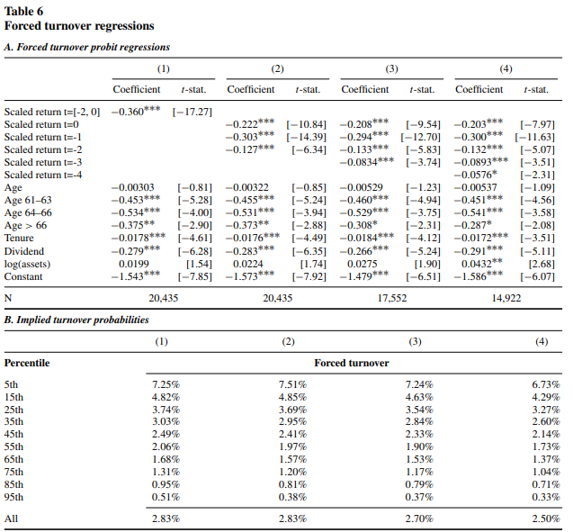
Notes:
1.
High-level summary of the table: Table 6 presents the results of standard probit regressions examining the relationship between forced CEO turnover and firm performance, mirroring the traditional approach in the CEO turnover literature. Panel A presents the regression coefficients for various measures of company performance and control variables. Panel B then shows the model-implied probabilities of a forced turnover for different percentiles of company performance.
2.
How the table fits in the overall narrative, why they included it: This table allows for a direct comparison between the authors’ new measure of performance-induced turnover and the traditional measure of forced turnover. By replicating the common approach of past research, the authors can directly demonstrate that focusing solely on forced turnovers likely underestimates the number of CEO departures caused by poor performance. This highlights the importance of their new, broader measure.12
3.
What the independent and dependent variables are:
○
Panel A:
■
Dependent variable: An indicator variable equal to 1 for tenure years with a forced CEO turnover and 0 otherwise.13
■
Independent variables: Decile indicators for the firm’s stock price performance (measured as the average industry-adjusted monthly stock return, scaled by their standard deviation), and a set of control variables including CEO age, CEO tenure, firm size, and an indicator for dividend payers.13
○
Panel B:
■
Independent variables: Percentiles of the company's stock price performance.4
■
Dependent variable: Model-implied probabilities of a forced turnover, calculated by setting the performance measure to the desired percentile and leaving all other variables at their actual values.4
4.
A short 2-paragraph script that I can read to explain it:
5.
"Table 6 presents the results of a standard statistical analysis of forced CEO turnover – the kind commonly used in academic research. The goal here is to directly compare this traditional approach with our new concept of performance-induced turnover. What we find is striking: while forced turnover is certainly related to company performance, both the overall rate of forced turnover and its sensitivity to poor performance are lower than what we see with performance-induced turnover (as shown in previous tables).1
6.
This difference arises because the traditional approach misses a crucial piece of the puzzle: many CEO departures that are classified as “voluntary” actually occur after periods of bad performance. By only looking at forced turnovers, we miss this broader trend and underestimate the true impact of performance on CEO departures. This reinforces the importance of using our new measure of performance-induced turnover to capture the full scope of how company performance affects CEO departures."2
copy_all
thumb_up
thumb_down
keep_pinSave to note

Slide 21
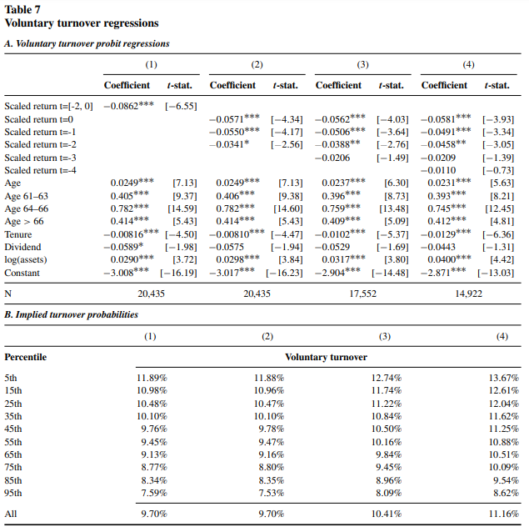
Notes:
Voluntary Turnover and Performance: Insights from Table 7
1.
High-level summary of the table: Table 7 examines the relationship between CEO departures classified as voluntary and firm performance. Similar in structure to Table 6, Panel A presents the results of probit regressions with voluntary turnover as the dependent variable. Panel B then presents the model-implied probabilities of voluntary turnover for different percentiles of company performance.
2.
How the table fits in the overall narrative, why they included it: This table is crucial in demonstrating why the traditional focus on forced turnover underestimates the impact of poor performance on CEO departures. By showing that even voluntary turnovers are more likely to occur following bad performance, the sources argue that many of these departures are actually performance-induced but masked as voluntary12. This reinforces the need for their broader measure of performance-induced turnover.
3.
What the independent and dependent variables are:
○
Panel A:
■
Dependent variable: An indicator variable equal to 1 for tenure years with a voluntary CEO turnover and 0 otherwise.
■
Independent variables: Decile indicators for the firm's stock price performance (measured as average industry-adjusted monthly stock returns scaled by their standard deviation) and a set of control variables including CEO age, CEO tenure, firm size, and an indicator for dividend payers.
○
Panel B:
■
Independent variables: Percentiles of the company's stock price performance.
■
Dependent variable: Model-implied probabilities of a voluntary turnover, calculated by setting the performance measure to the desired percentile and leaving all other variables at their actual values.
4.
A short 2-paragraph script that I can read to explain it:
5.
"Table 7 digs deeper into the relationship between company performance and CEO departures that are classified as voluntary. What we see here challenges the traditional assumption that voluntary departures are entirely unrelated to performance. The regression results in Panel A show a statistically significant negative relationship between company performance and the likelihood of a voluntary turnover.
6.
This means that even though these departures aren't classified as forced, they are still more likely to happen when the company is doing poorly. Panel B makes this even clearer: the chance of a CEO leaving voluntarily increases significantly as we move from the top performers to the bottom performers. This supports our argument that many so-called “voluntary” departures are actually driven by poor performance, further emphasizing the need to look beyond the traditional forced turnover measure."

Slide 22
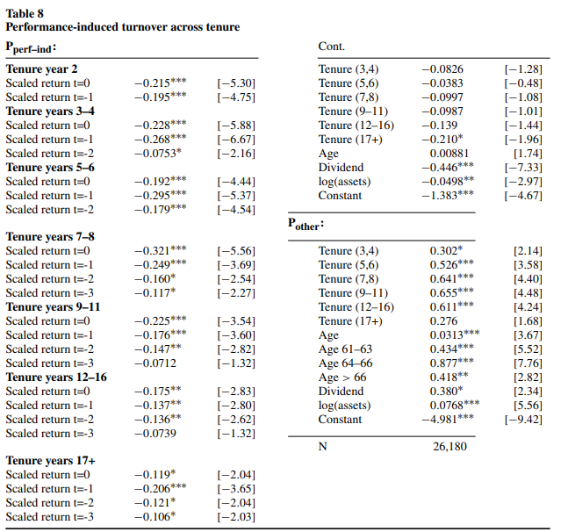
Notes:
Tenure and Turnover Dynamics: Analyzing Table 8
1.
High-level summary of the table: Table 8 presents the results of a two-probit model that examines how the relationship between firm performance and performance-induced CEO turnover changes as CEOs gain more tenure. The table presents coefficients for separate performance measures for each of seven tenure periods: year 2, years 3-4, years 5-6, years 7-8, years 9-11, years 12-16, and 17 or more years.
2.
How the table fits in the overall narrative, why they included it: This table examines a key prediction of Bayesian learning models of CEO turnover: boards should become more certain about a CEO's ability over time, leading to a weaker relationship between performance and turnover as CEO tenure increases. This analysis allows the sources to further explore whether observed turnover patterns are consistent with these models.
3.
What the independent and dependent variables are:
○
Dependent variable: An indicator variable equal to 1 if the CEO left the firm in a given year and 0 otherwise. This is modeled using two probit equations: one to capture performance-induced turnover (Pperf-ind) and one to capture other types of turnover (Pother).
○
Independent variables:
■
For Pperf-ind: Average industry-adjusted monthly stock returns per tenure year (scaled by their standard deviation) for each of the past four years, interacted with indicators for each of the seven tenure periods.
■
For Pother: CEO age, indicator variables for three age ranges (61-63, 64-66, 66+), CEO tenure, an indicator for dividend-paying firms, and the log of the firm's book assets. Control variables are the same for both probit equations.
4.
A short 2-paragraph script that I can read to explain it:
5.
"Table 8 explores how the link between company performance and performance-induced CEO turnover changes as CEOs gain experience. The standard Bayesian learning model suggests that as CEOs spend more time at a firm, boards should become more confident in their assessment of their abilities. This increased certainty should, in theory, lead to a weaker connection between recent performance and the likelihood of a performance-induced departure.
6.
However, our analysis challenges this prediction. We find that the sensitivity of performance-induced turnover to recent performance doesn't decline significantly, at least for the first 10 years of a CEO's tenure. This suggests that boards may continue to rely heavily on recent performance even when a CEO has a long track record. This finding is consistent with a model in which CEO ability isn't constant, but rather is subject to shocks and changes over time, making it harder for boards to form a stable, long-term assessment."

Slide 23
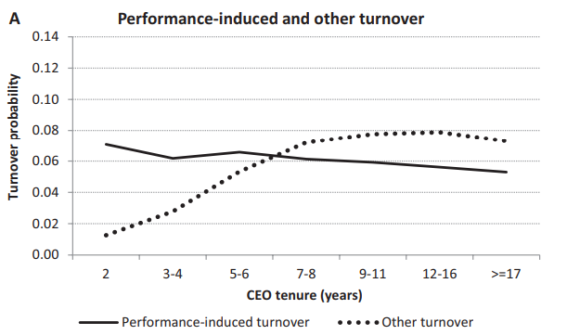

Slide 24
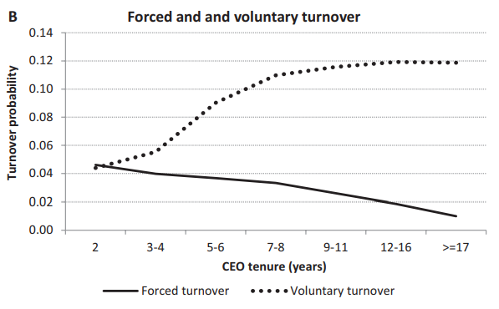

Slide 25
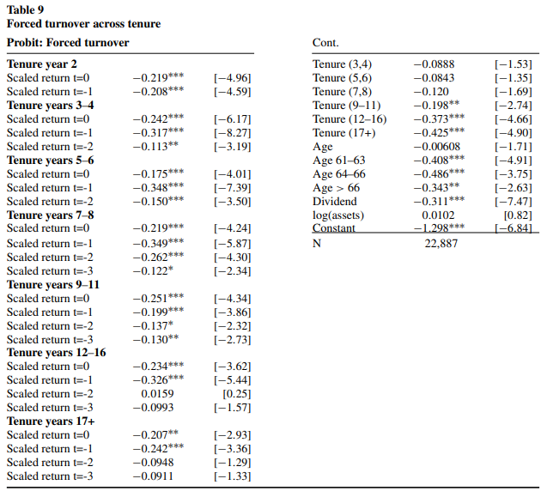
Notes:
Analyzing the Relationship Between Tenure and Forced Turnover: Table 9
1.
High-level summary of the table: Table 9 examines how the relationship between firm performance and forced CEO turnover changes as CEOs accumulate more tenure. It presents the results of a standard probit regression, with forced turnover as the dependent variable, where performance measures are interacted with dummies for seven different CEO tenure periods: year 2, years 3-4, years 5-6, years 7-8, years 9-11, years 12-16, and 17 or more years.12
2.
How the table fits in the overall narrative, why they included it: This table serves two main purposes. First, it replicates the analysis from Table 8, which focused on performance-induced turnover, but now using the traditional measure of forced turnover. This helps to ensure that the conclusions from the previous analysis aren't simply an artifact of using the new performance-induced turnover measure. Second, it allows the sources to further explore whether the observed patterns of forced CEO turnover are consistent with predictions from Bayesian learning models. The expectation, based on those models, is that boards should become more certain about a CEO's ability as their tenure grows, leading to a weaker relationship between performance and the likelihood of forced turnover.13
3.
What the independent and dependent variables are:
○
Dependent variable: An indicator variable equal to 1 if the CEO was forced out of the firm in a given year and 0 otherwise.2
○
Independent variables:
■
Average industry-adjusted monthly stock returns per tenure year (scaled by their standard deviation) for each of the past four years, interacted with indicators for each of the seven tenure periods.2
■
Control variables including CEO age, indicator variables for three age ranges (61-63, 64-66, 66+), CEO tenure, an indicator for dividend-paying firms, and the log of the firm's book assets.2
4.
A short 2-paragraph script that I can read to explain it:
5.
"Table 9 examines how the likelihood of a forced CEO turnover changes with both company performance and the CEO’s time in office. Bayesian learning models suggest that as a CEO gains tenure, the board should become more certain of their abilities, making recent performance less important in their decision to fire them. In theory, this means we should see a weaker relationship between recent performance and forced turnover as CEOs gain experience.
6.
However, our analysis doesn’t fully support this prediction. While there's some indication that the sensitivity to performance might decrease slightly after 11 years of tenure, we find that the relationship between recent performance and forced turnover remains relatively strong even for CEOs with long tenures. This, again, suggests that boards might not gain as much certainty about a CEO's ability over time as traditional models predict. It could be that CEO ability changes over time, making it difficult for boards to develop a stable, long-term assessment.”12

Slide 26
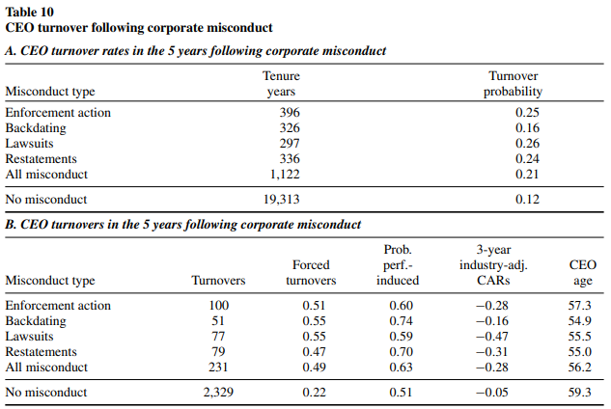
Notes:
1.
High-level summary of the table: Table 10 explores CEO turnover in the aftermath of corporate misconduct. Panel A presents descriptive statistics on the frequency of CEO departures in the five years following the end of a misconduct event. Panel B focuses specifically on those CEO turnovers that occurred after misconduct, examining the proportion categorized as forced, the average probability of being performance-induced, and the average 3-year industry-adjusted cumulative abnormal returns (CARs) leading up to the turnover.
2.
How the table fits in the overall narrative, why they included it: This table allows the sources to explore a specific context where the distinction between performance-induced and forced turnover may be particularly relevant. Corporate misconduct provides a unique setting to analyze how boards react to negative events that may not be directly tied to firm performance. The analysis of CEO turnover following misconduct sheds further light on the dynamics of performance-induced turnover and the factors influencing board decisions.
3.
What the independent and dependent variables are:
○
Not applicable. Table 10 presents descriptive statistics rather than the results of a regression analysis. It summarizes observed patterns of CEO turnover following instances of corporate misconduct.
4.
A short 2-paragraph script that I can read to explain it:
5.
"Table 10 shifts our attention to CEO departures following incidents of corporate misconduct, like accounting irregularities or regulatory violations. We examine how often CEOs leave their positions in the five years after these events conclude. Panel A shows a notable increase in CEO turnover during this period, with a departure rate of 21% per year compared to 12% in other years. This suggests that misconduct does have a significant impact on the stability of CEO positions.
6.
Panel B digs deeper into the nature of these post-misconduct departures. Interestingly, we see a much higher proportion of these turnovers classified as forced, almost half, compared to 22% in other years. This makes sense, as boards may be more likely to explicitly remove a CEO following a serious transgression. We also find that these post-misconduct departures are more likely to occur after periods of poor stock performance, indicated by the negative 3-year CARs."

Slide 27
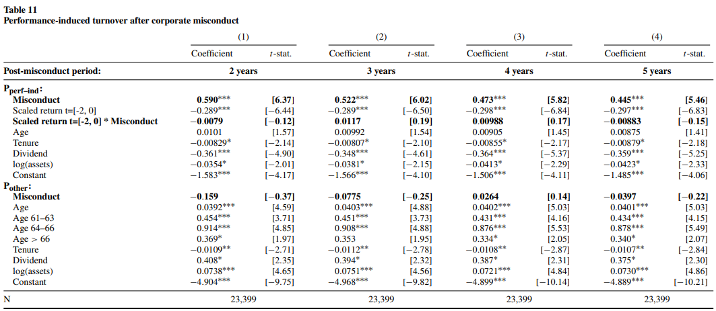
Notes:
Investigating the Impact of Misconduct on Turnover: Table 11
1.
High-level summary of the table: Table 11 uses a two-probit model to assess how corporate misconduct influences both performance-induced and other types of CEO turnover. The key feature of this analysis is the inclusion of a misconduct indicator and its interaction with firm performance in the performance-induced turnover portion of the model. This allows the sources to isolate the unique effect of misconduct on CEO departures.
2.
How the table fits in the overall narrative, why they included it: This analysis builds upon the previous exploration of performance-induced and forced turnover. The sources have established that misconduct often leads to elevated CEO turnover. Now, they seek to determine how misconduct affects the relationship between performance and turnover. This table helps to understand whether boards hold CEOs to a different standard of performance in the wake of misconduct and whether misconduct itself acts as a distinct signal that can trigger a CEO's departure.
3.
What the independent and dependent variables are:
○
Dependent variable: An indicator variable equal to 1 if the CEO left the firm in a given year and 0 otherwise. This is modeled using two probit equations: one to capture performance-induced turnover (Pperf-ind) and one to capture other types of turnover (Pother).
○
Independent variables:
■
For Pperf-ind: The primary variables of interest are (1) a misconduct indicator that spans from the year the misconduct ends to 1 to 4 years later (depending on the model specification) and (2) the interaction of this indicator with average industry-adjusted monthly stock returns over the past three years (scaled by their standard deviation). The model also includes the scaled returns themselves and controls for CEO age, tenure, whether the firm pays dividends, and the log of its book assets.
■
For Pother: The same control variables as in the Pperf-ind equation are included, along with a standalone misconduct indicator (without interaction with performance).
4.
A short 2-paragraph script that I can read to explain it:
5.
"Table 11 examines the specific influence of corporate misconduct on CEO turnover. We know from previous analysis that CEOs are more likely to leave their positions following misconduct. Here, we investigate whether this is simply due to poor performance that often accompanies these events, or if the misconduct itself has an independent impact on the board's decision-making. To do this, we incorporate a misconduct indicator into our two-probit model, which already accounts for the relationship between firm performance and turnover.
6.
Our findings indicate that misconduct does have a unique effect, separate from performance, on the likelihood of a CEO leaving. The presence of misconduct significantly increases the probability of a performance-induced turnover, even after controlling for company performance. This suggests that boards may be more inclined to remove CEOs after misconduct, holding them to a higher standard or treating the misconduct as a distinct negative signal about their leadership."

Slide 28
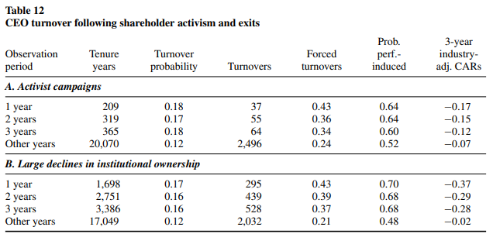
Notes:
Shareholder Influence and CEO Turnover: Examining Table 12
1.
High-level summary of the table: Table 12 presents descriptive statistics on CEO turnover in the three years following two types of significant shareholder events: activist campaigns (Panel A) and large declines in institutional ownership (Panel B). For each event type, it reports the number of CEOs experiencing the event, the overall CEO turnover probability, the proportion of turnovers classified as forced, the average probability of being performance-induced, and the average 3-year industry-adjusted cumulative abnormal returns (CARs) preceding the turnover.
2.
How the table fits in the overall narrative, why they included it: This table extends the sources' investigation of performance-induced turnover by examining its prevalence in situations involving increased shareholder pressure. Activist investors, by definition, seek to influence corporate actions, which often includes advocating for leadership changes. Large institutional investors can also exert pressure on boards through their voting power or by exiting their positions. Analyzing turnover in these specific contexts helps to assess whether shareholder activism and institutional exits are associated with a higher likelihood of performance-related CEO departures.
3.
What the independent and dependent variables are: Similar to Table 10, Table 12 presents descriptive statistics rather than the results of a regression analysis. It summarizes observed patterns of CEO turnover following specific shareholder-related events.
4.
A short 2-paragraph script that I can read to explain it:
5.
"Table 12 examines how CEO turnover is affected by two types of shareholder actions: activist campaigns and large declines in institutional ownership. These actions often signal dissatisfaction with a company's performance or direction and can lead to pressure on the board to make changes, including replacing the CEO. We track CEO departures in the three years following each type of event.
6.
The data reveals that CEO turnover increases notably in the year of these events, with rates rising to 18% for activism and 17% for institutional exits, compared to a baseline rate of 12%. Importantly, a larger share of these departures are classified as forced, and the average probability of being performance-induced is also higher than usual. This suggests that shareholder activism and institutional exits might indeed trigger boards to take action against underperforming CEOs."

Slide 29
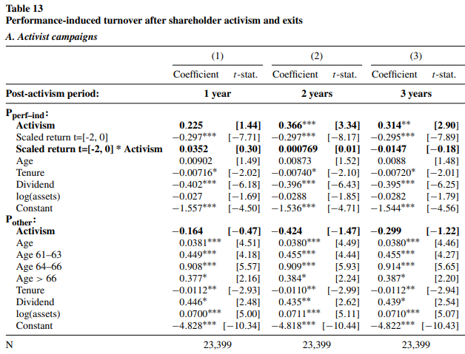
Notes:
Evaluating Shareholder Influence with the Two-Probit Model: Table 13
1.
High-level summary of the table: Table 13 utilizes the two-probit model framework to rigorously examine the link between shareholder activism/exits and CEO turnover, controlling for firm performance. Panel A focuses on activist campaigns, while Panel B analyzes large declines in institutional ownership. Each panel presents the coefficients and t-statistics from the two probit equations: one for performance-induced turnover (Pperf–ind) and one for other turnover (Pother). Key independent variables include indicators capturing the periods following the shareholder events, their interaction with firm performance, and the standard set of controls.
2.
How the table fits in the overall narrative, why they included it: Building on the descriptive findings from Table 12, which suggested a potential relationship between shareholder pressure and CEO turnover, Table 13 seeks a more definitive answer by employing a more robust statistical analysis. The two-probit model allows the sources to isolate the specific effect of these shareholder events on CEO departures while accounting for the influence of firm performance. This approach helps determine whether these events independently contribute to CEO turnover or merely reflect responses to poor company performance.
3.
What the independent and dependent variables are:
○
Dependent variable: Similar to Table 11, the dependent variable is an indicator, equal to 1 if the CEO left the firm in a given year and 0 otherwise. This is modeled using two probit equations: one to capture performance-induced turnover (Pperf-ind) and one to capture other types of turnover (Pother).
○
Independent variables:
■
For both Pperf-ind and Pother:
●
A key variable is an indicator capturing the 1-year, 2-year, or 3-year period following the shareholder event (depending on the model specification). This helps assess the temporal impact of the event on turnover.
●
In the Pperf-ind equation, this event indicator is also interacted with the average industry-adjusted monthly stock returns over the past three years (scaled by their standard deviation). This interaction allows the sources to determine whether the relationship between firm performance and turnover changes after shareholder activism or institutional exits.
■
The models further include the scaled returns themselves and controls for CEO age, tenure, whether the firm pays dividends, and the log of its book assets.
4.
A short 2-paragraph script that I can read to explain it:
5.
"Table 13 takes our analysis of shareholder influence on CEO turnover a step further. We move beyond simple descriptive statistics and employ the two-probit model, allowing us to control for company performance while evaluating the impact of activist campaigns and large institutional exits. This helps disentangle the effects of shareholder pressure from those of underlying company performance.
6.
The results are quite interesting. We find that activist campaigns, especially those lasting over two or three years, are significantly associated with an increased probability of performance-induced CEO turnover. This suggests that activist investors might indeed be successful in pushing boards to hold CEOs accountable for performance. On the other hand, the effect of large declines in institutional ownership appears less pronounced, with only a modest increase in performance-induced turnover observed."

Slide 30
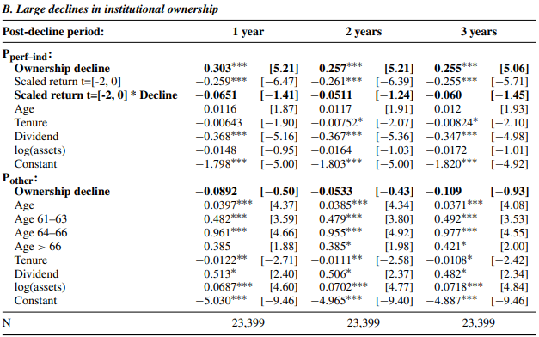

Slide 31
Conclusion
Performance-induced CEO turnover provides a more comprehensive approach to studying the relationship between firm performance and CEO departures than traditional forced vs. voluntary classifications. Many CEO departures labeled as "voluntary" are likely driven by poor performance.
The two-probit model effectively isolates the impact of performance on CEO turnover and is consistent with the finding that recent performance (3–4 years) strongly influences turnover decisions. This challenges the traditional view of CEO entrenchment and suggests boards remain sensitive to performance throughout a CEO's tenure.
Future research should explore alternative models, such as those with dynamic CEO ability, to better explain the observed patterns of CEO turnover. This will advance our understanding of the complex relationship between CEO performance, board decisions, and CEO-firm separations.

